Slide 1

Original author: Yehuda Katz
https://github.com/emberjs/ember.js/
http://emberjs.com/
Current version v2.7.0
Notes:
Self-introduction and quick introduction about Ember.js (history, author, version …. )
1 min

Slide 2
Agenda
Ember.js Core Concepts
Organizing Ember application
Practical concerns (TBU) / Lessons learned (TBU)
Notes:
Briefing agenda, quick walkthrough
Core concepts: how an Ember application works (basic structure), what tools provided out of the box
Organize Ember app: standard MVC structure, Ember POD structure, Unified structure (just theory for the moment) and demo a real-world application structure
Concerns: server-side rendering with FastBoot, build tool (ember-cli)
1 min

Slide 3
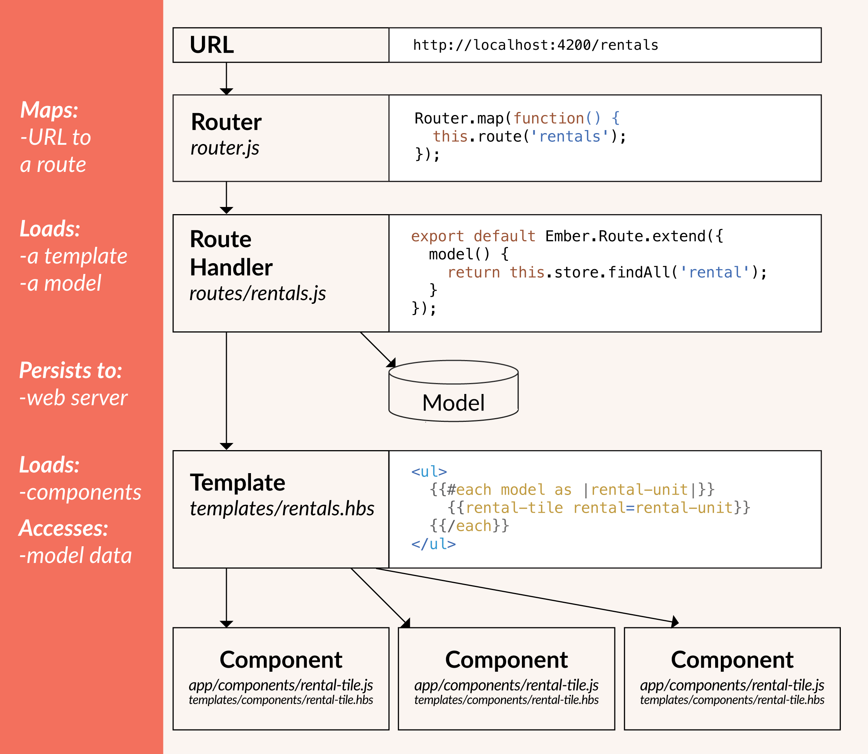
Core concepts - Overview
Notes:
Brief introduction to some of Ember core concepts and overview of all
Routing (define route and route handler)
HTML template with Handlebars
Model
2 mins

Slide 4
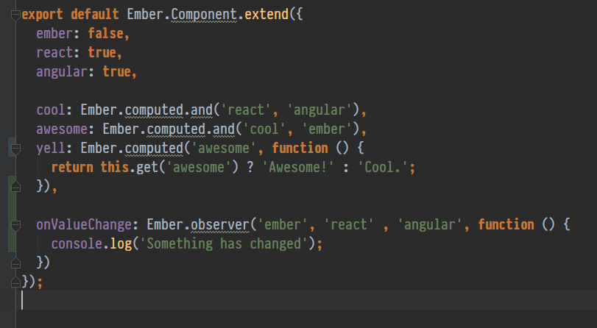
Core concepts
Objects in Ember
Computed Properties
Observers
Bindings
Notes:
Should not be confused with Model.
Models are objects that represent the underlying data. (And it uses Ember object not plain JavaScript object)
5 mins – including demo

Slide 5
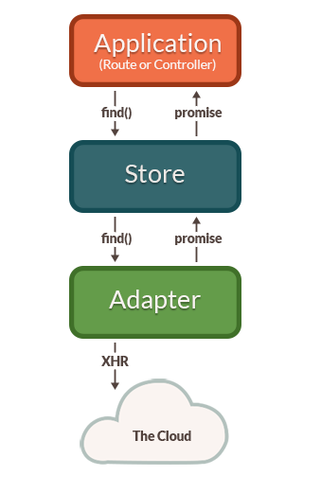
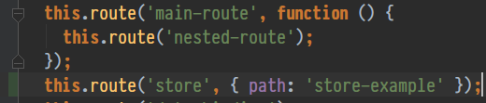
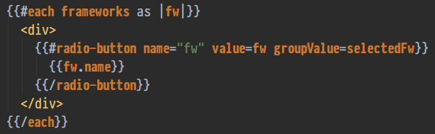
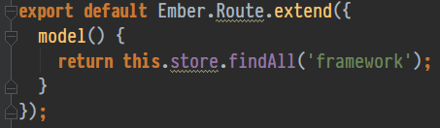
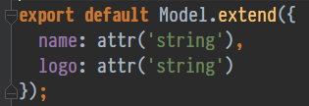

Core concepts
Routes
Templates
Components
Model
Store
Notes:
This is main part.
Everything is provided out of the box, we don’t have to config anything else.
Explain how store and model works, ajax request and API querying without much efforts, configs.
5-7 mins – including demo

Slide 6
Organizing your application
Standard MVC structure:
app/routes/main-route.js
app/routes/main-route/nested-route.js
app/templates/main-route.hbs
PODS structure:
app/pods/main-route/route.js
app/pods/main-route/template.hbs
app/pods/main-route/nested-route/route.js
app/pods/main-route/nested-route/template.hbs
app/pods/other-route/route.js
app/pods/other-route/template.hbs
Notes:
Group by type,
Group by feature, others can be centralized, such as: services, adapters, models (define in one place and use for all other components, route).

Slide 7
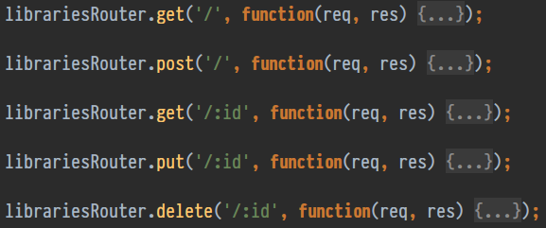
Practical concerns / Lessons learned
Standard REST API querying
Development
Server-side rendering
Notes:
1 - End up writing ajax middleware if the API does not follow REST or JSONAPI standard, in some cases we have to manage data on our own =>
can’t leverage the store which is one of the best features of Ember.
2 – Fast and easy development environment with ember-cli, just one command line and you have a fully functional mockup API, generated route/component
3 – Now possible with FastBoot
Some other concerns:
Using ES6/7 with Ember ( `this` context)
Rendering performance (Glimmer)
Tightly coupling with jQuery

Slide 8
Thanks for listening!
Notes:
Takeaway values:
Basic concepts
Some factors that will help to determine to use in your project or not

